Slide 1
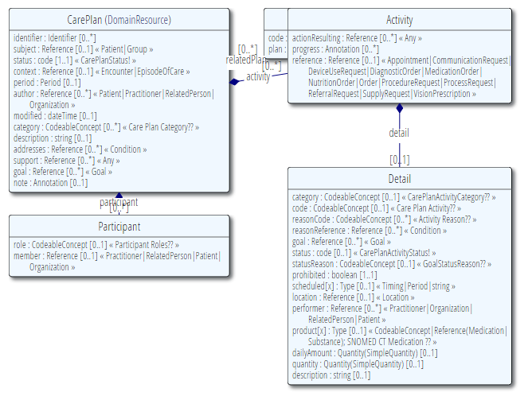
Care Plan Domain: Key inputs
FHIR
C-CDA
Care Plan Domain Analysis Model
Care Plan
Concerns
Goals
Interventions
Outcomes

Slide 2
Current Status
Disposition | Count
Relaxed | 5
Defined, not yet specified | 4
Change to association | 2
Removed | 2
In process | 1
Merged | 1
Specified | 1
Not yet started | 14

Slide 3
Legend
Relaxed
Precondition: unlikely to be encoded; made text
Defined, not yet specified
Plan category: allow discipline (Provider Taxonomy), condition (SNOMED CT), setting (HCPCS)
Change to association
Reason: point at concern
Removed
Intervention functional area: if needed can be inferred from intervention
Merged
Discipline now part of Category
Specified
Level of Risk to use existing FHIR value set

Slide 4
Remaining Elements
Most remaining elements are unique to the Domain Analysis Model, and may be forward-looking elements
Preferences
Possible overlap with advance directives
Subjective
Reviews
Guidance from goal review

